Slide 1
Exploratory Data Analysis with R

Slide 2
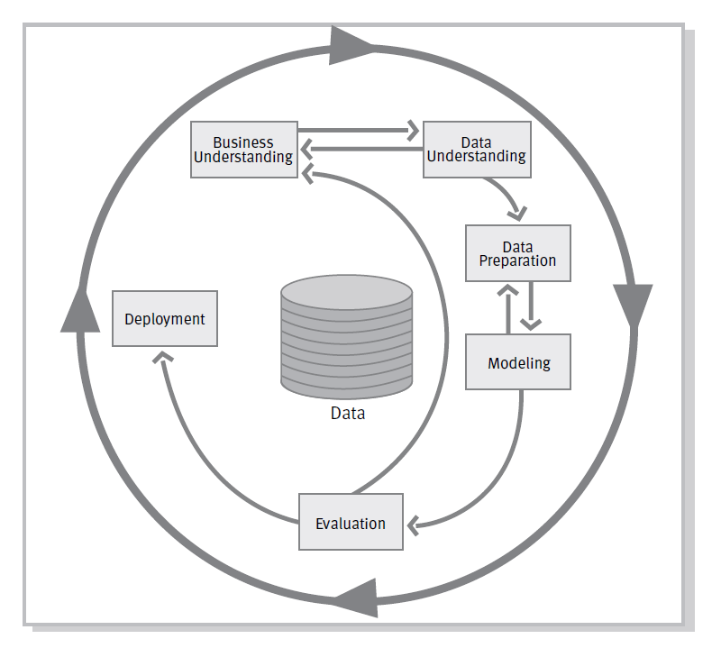
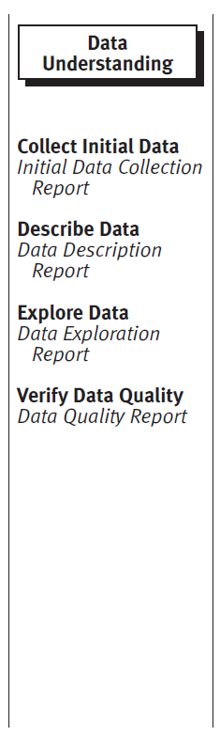
The CRISP-DM Model

Slide 3
Previous IWDS workshop
Dataset: https://data.gov.uk/dataset/road-safety
Tasks for today:
Collect initial data
Data Description Report
Data Exploration Report
Data Quality Report

Slide 4
IWDS workshop today: Exploratory data analysis with R overview
The Data
Examining missing values and data imputation
Examining and dealing with outliers
Correlation matrices
Other plots

Slide 5
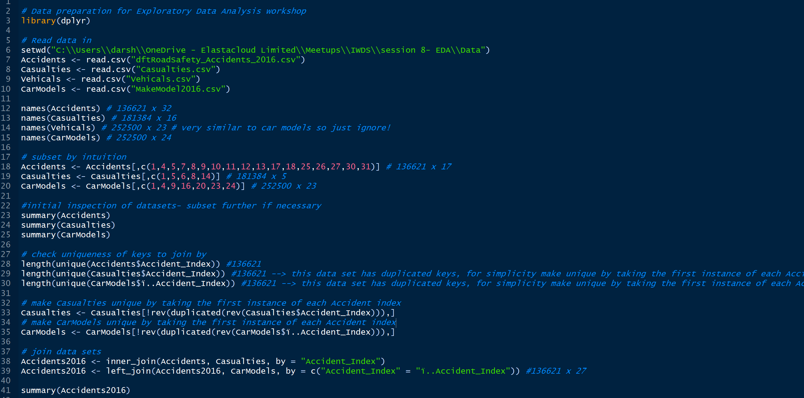
The Data has been prepared for you

Slide 6
Examining missing values and imputation
Summary()
Visualise missing values
10% rule: it is appropriate to impute missing values when 10% is missing. If we impute data with more than 10% of that column missing then artificial relationships can be introduced leading to errors.
https://www.analyticsvidhya.com/blog/2016/03/tutorial-powerful-packages-imputing-missing-values/

Slide 7
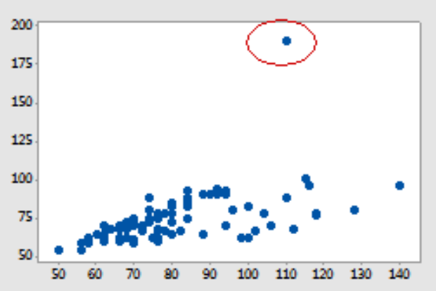
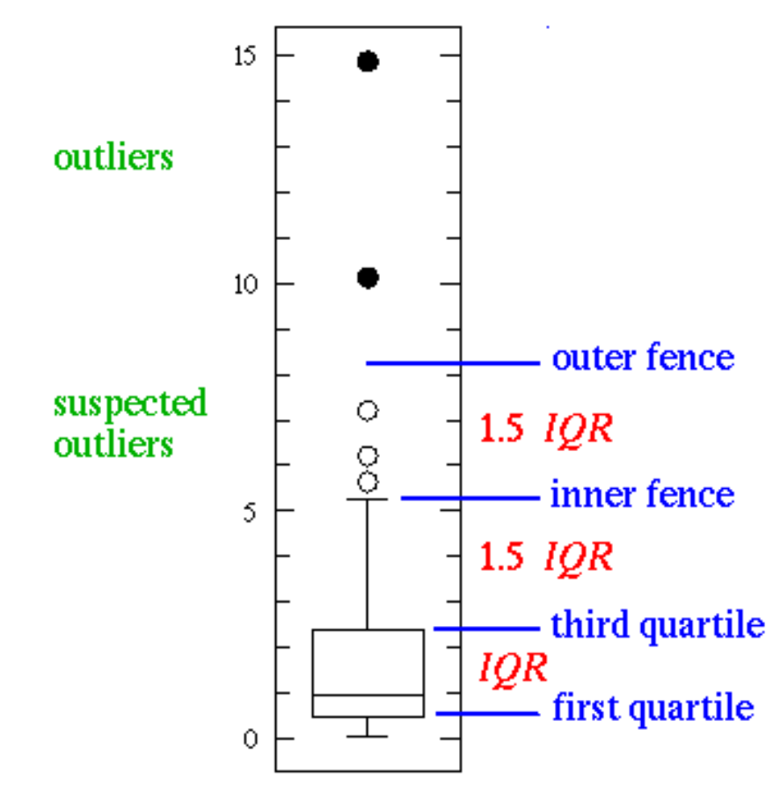
Examining and dealing with outliers
Summary
Useful link

Slide 8
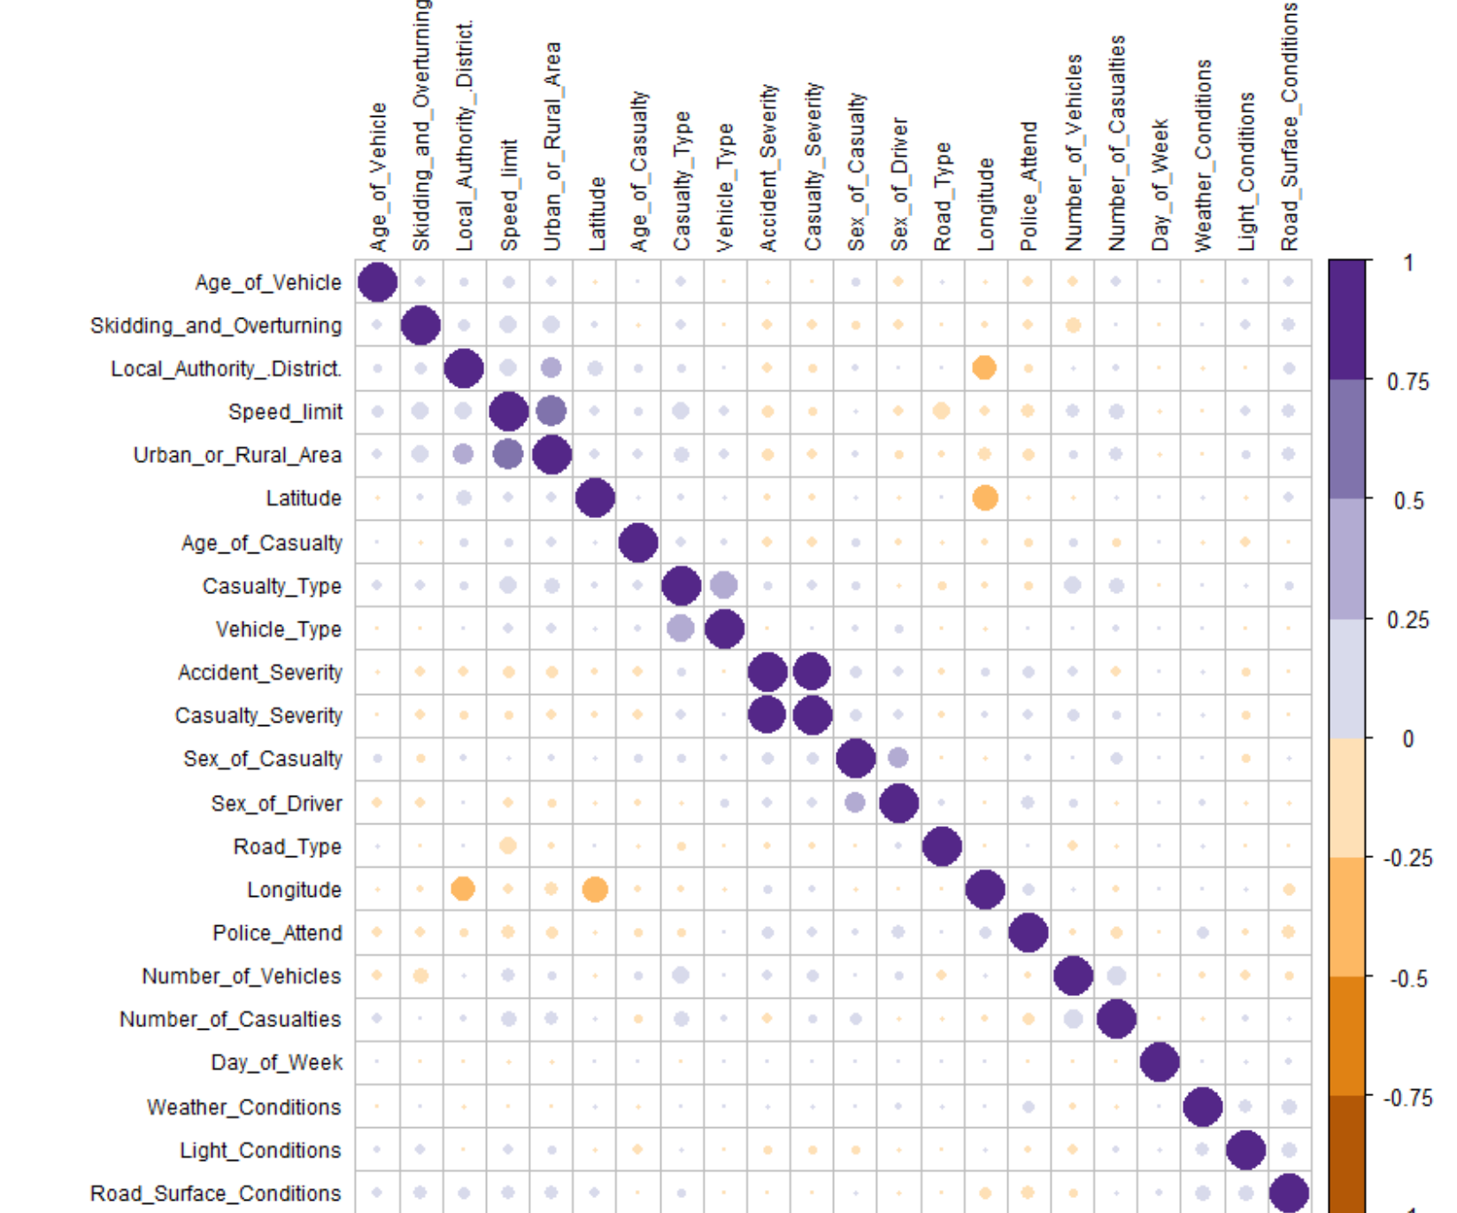
Correlation matrices

Slide 9
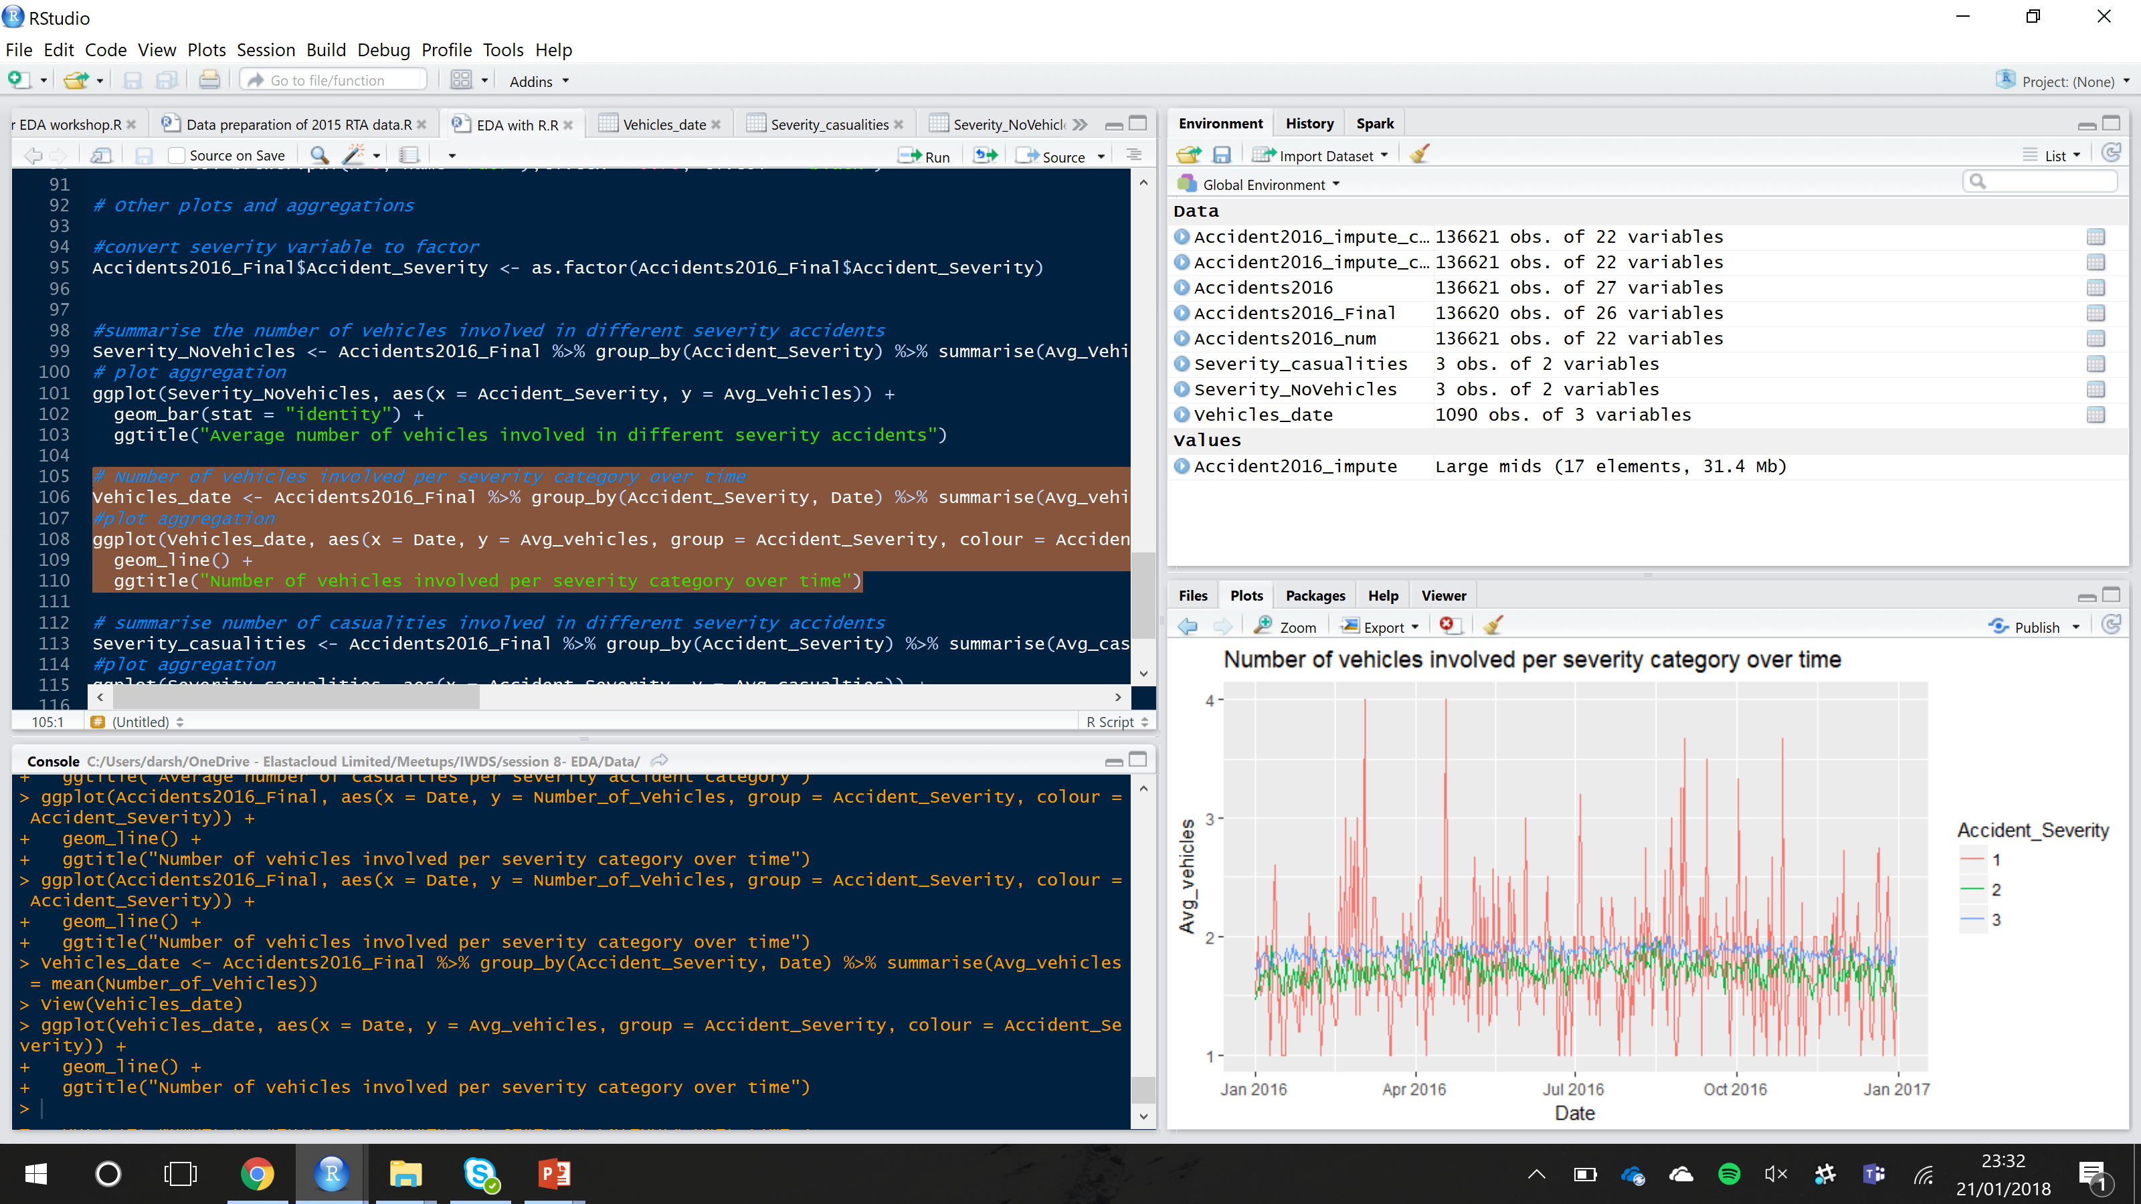
Other plots

Slide 10
Go through R script

Slide 11
Tasks
Choose from task 1 or if you are feeling ambitious try task 2:
1). Using dplyr, ggplot2 and corrplot R packages explore the data using aggregations, plots and correlation matrices (using the Road traffic accident 2016 data)
2). Use the Road traffic accident 2015 data and have a go at: a).examining and imputing missing data
b).examining and dealing with outliers
c). Explore the data with plots
d). Are there any differences between 2015 and 2016 in severity?

Slide 12
Useful links
Data imputation
outliers
Dplyr
Ggplot2

